Slide 2
Network structure

Slide 3
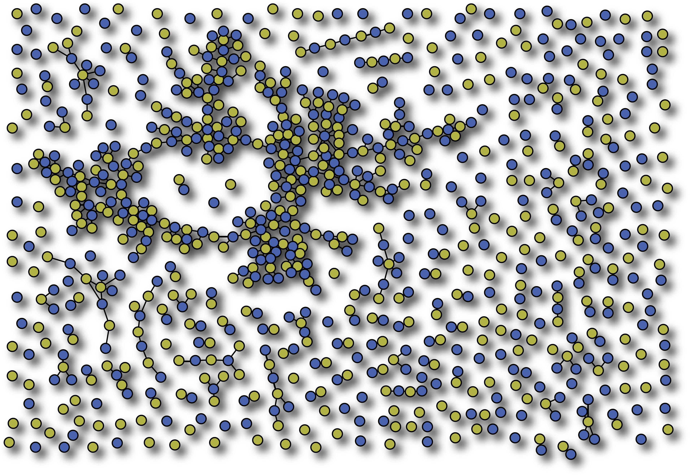
Network structure

Slide 4
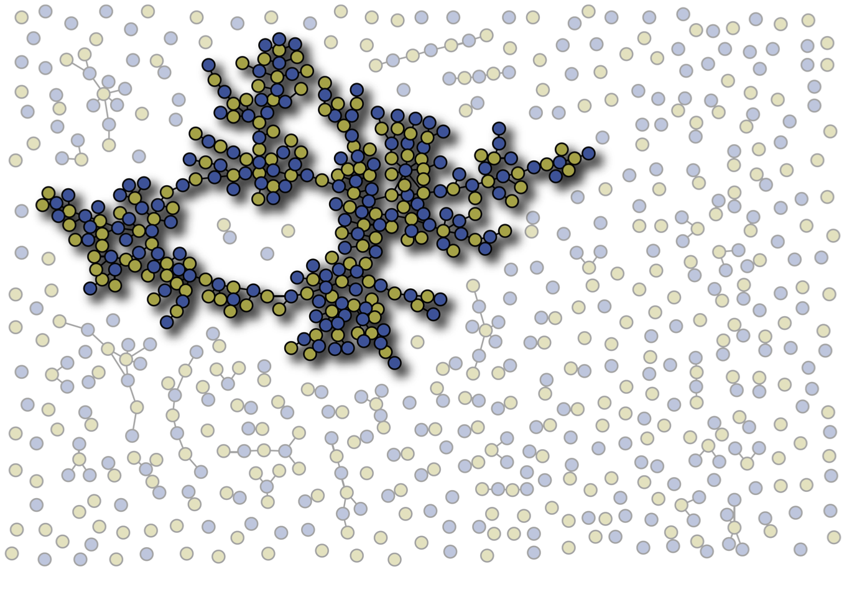
Network structure

Slide 5
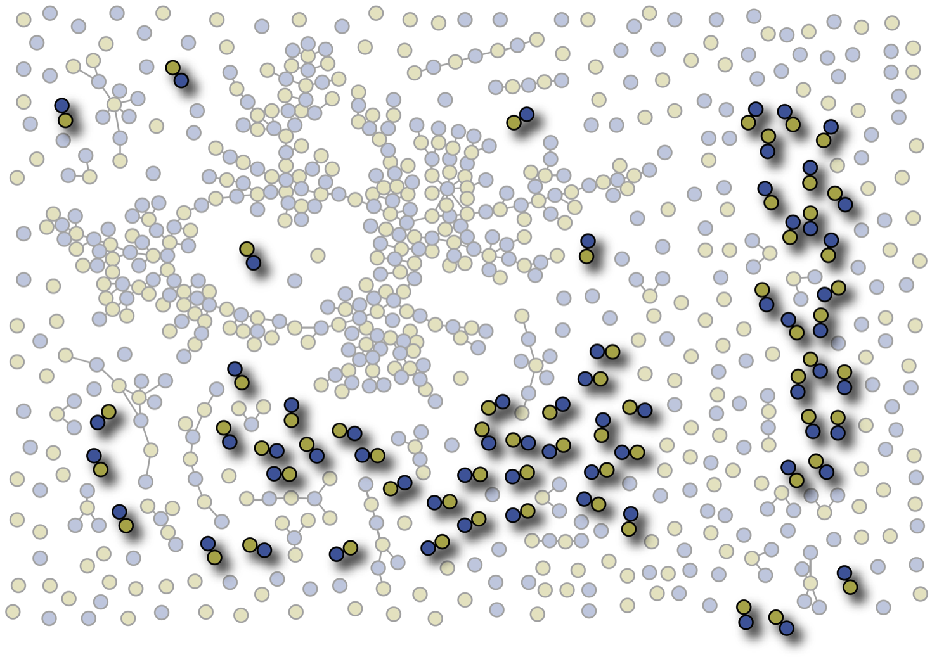
Network structure

Slide 6
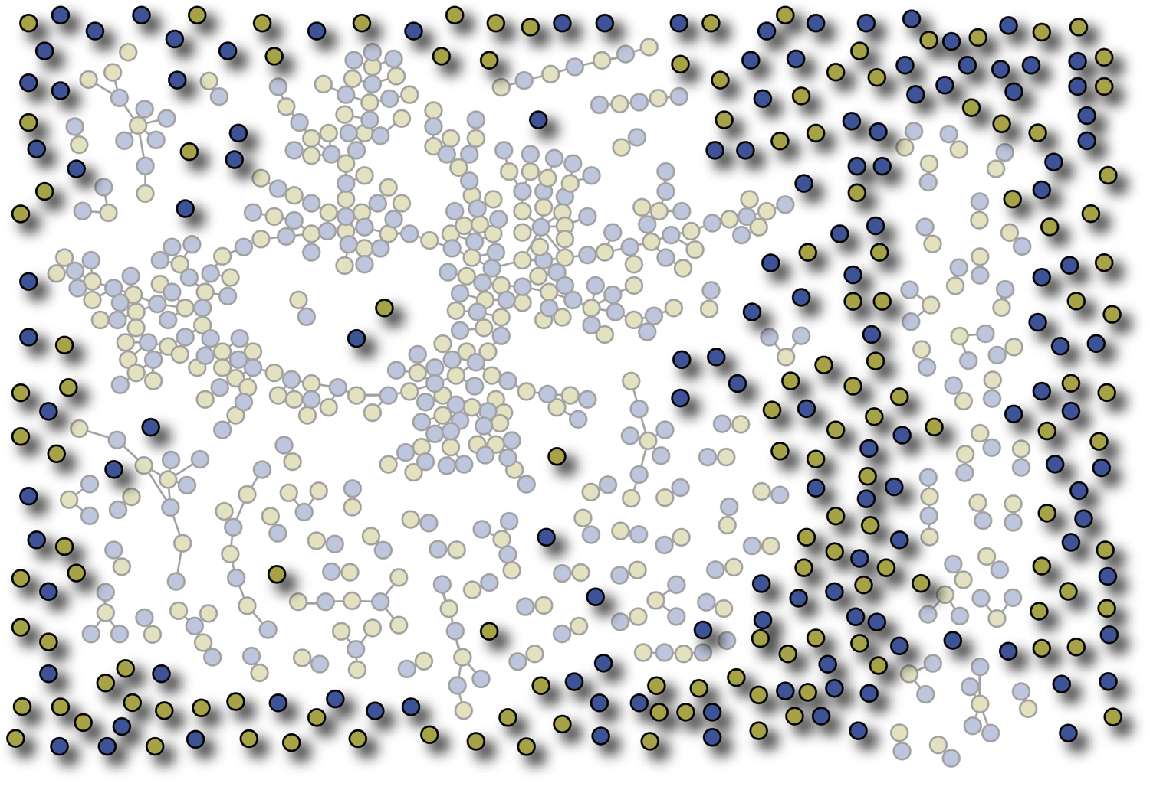
Network structure

Slide 7
Disease spreading
on static networks

Slide 8
SI model on static networks

Slide 9
SI model on static networks

Slide 10
SI model on static networks

Slide 11
SI model on static networks

Slide 12
SI model on static networks

Slide 13
SI model on static networks

Slide 14
SI model on static networks

Slide 15
SI model on static networks

Slide 16
SI model on static networks

Slide 17
SI model on static networks

Slide 18
SI model on static networks

Slide 19
SI model on static networks

Slide 20
SI model on static networks

Slide 21
SI model on static networks

Slide 22
SI model on static networks

Slide 23
SI model on static networks

Slide 24
SI model on static networks

Slide 25
SI model on static networks

Slide 26
Disease spreading on
temporal networks

Slide 27
Disease spreading on temporal networks

Slide 28
Disease spreading on temporal networks

Slide 29
Disease spreading on temporal networks

Slide 30
Disease spreading on temporal networks

Slide 31
Disease spreading on temporal networks

Slide 32
Disease spreading on temporal networks

Slide 33
Disease spreading on temporal networks

Slide 34
Disease spreading on temporal networks

Slide 35
Disease spreading on temporal networks

Slide 36
Disease spreading on temporal networks

Slide 37
Disease spreading on temporal networks

Slide 38
Disease spreading on temporal networks

Slide 39
Disease spreading on temporal networks

Slide 40
Disease spreading on temporal networks

Slide 41
Disease spreading on temporal networks

Slide 42
Disease spreading on temporal networks

Slide 43
Disease spreading on temporal networks

Slide 44
Disease spreading on temporal networks

Slide 45
Disease spreading on temporal networks

Slide 46
Disease spreading on temporal networks

Slide 47
Disease spreading on temporal networks

Slide 48
Disease spreading on temporal networks

Slide 49
Disease spreading on temporal networks

Slide 50
Disease spreading on temporal networks

Slide 51
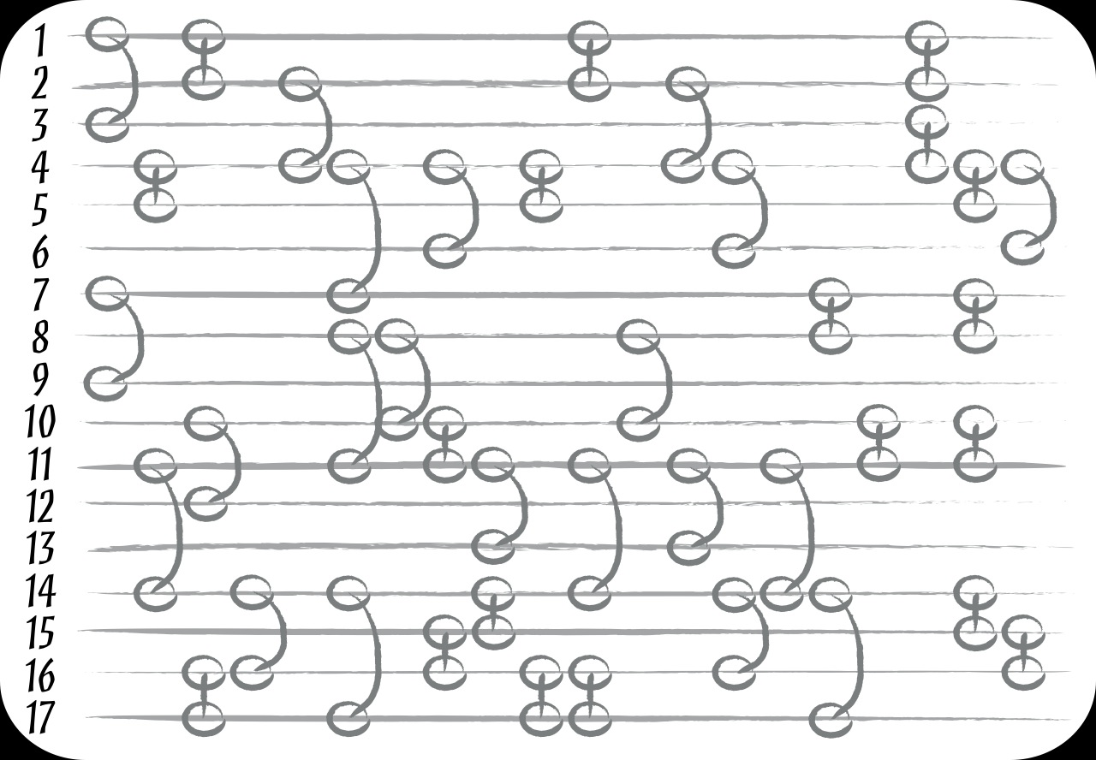
Disease spreading on temporal networks
time

Slide 52
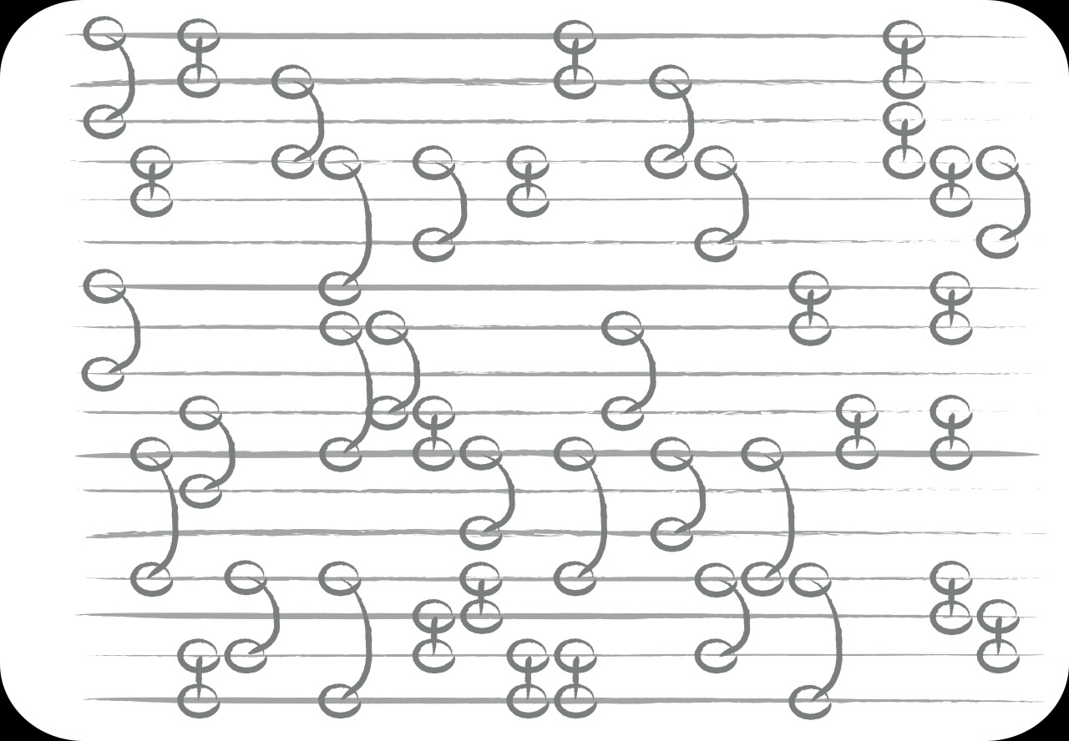
Disease spreading on temporal networks
time

Slide 53
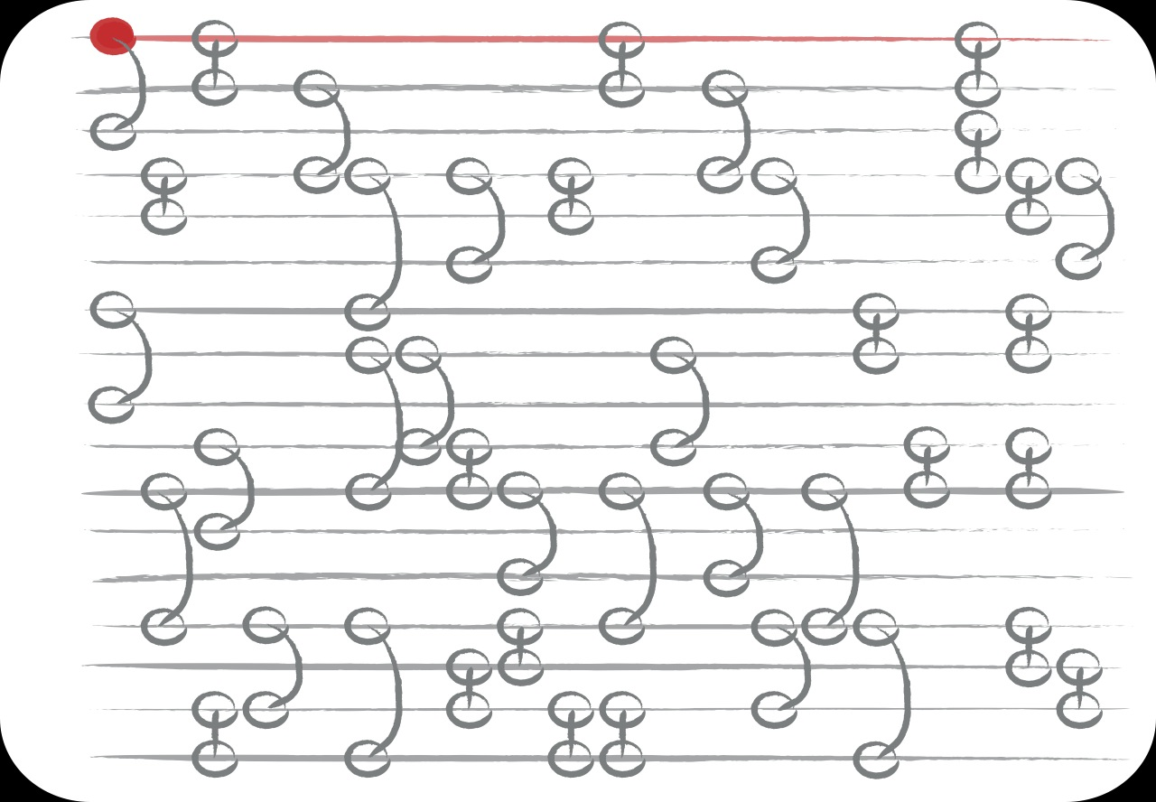
Disease spreading on temporal networks
time

Slide 54
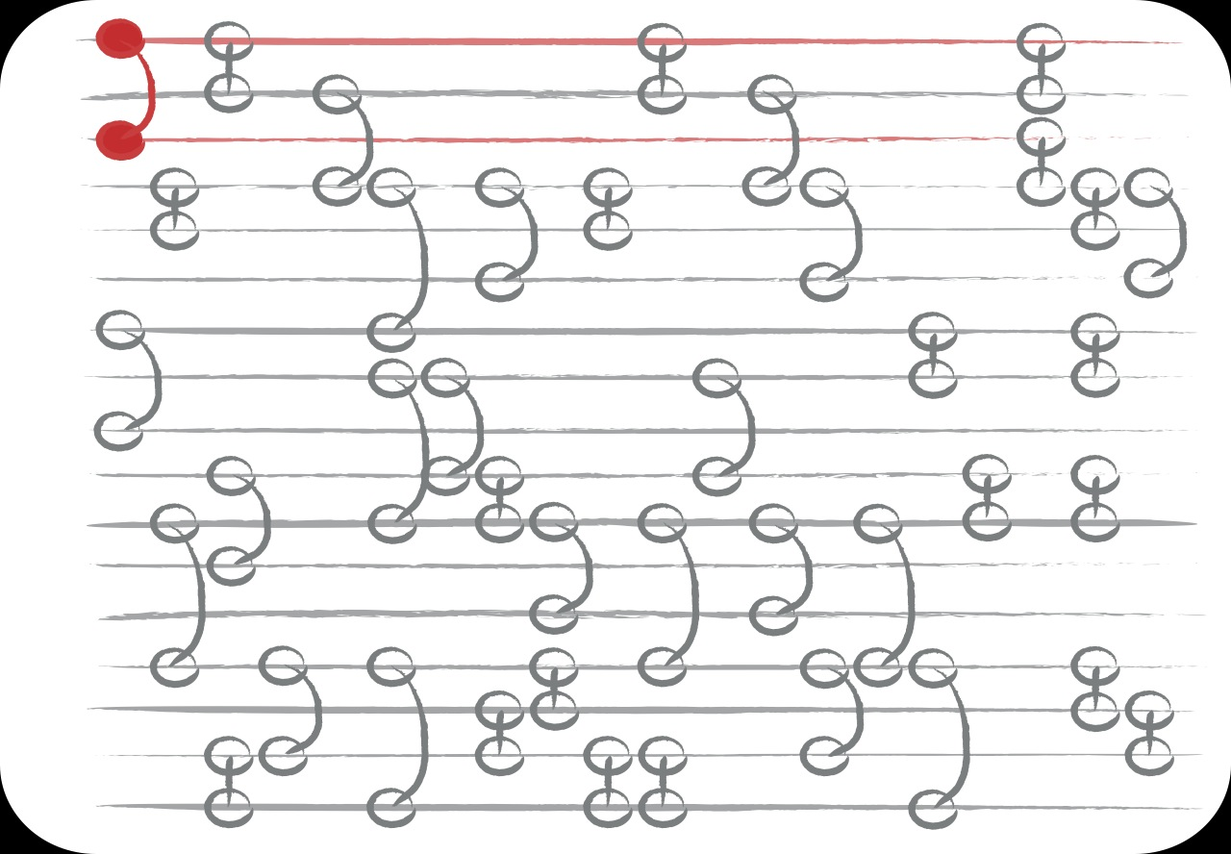
Disease spreading on temporal networks
time

Slide 55
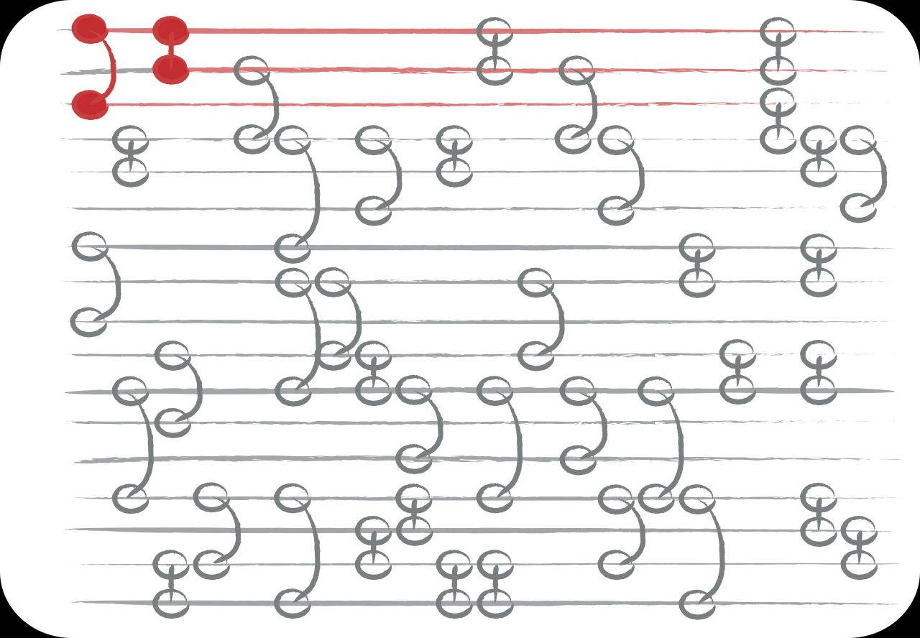
Disease spreading on temporal networks
time

Slide 56
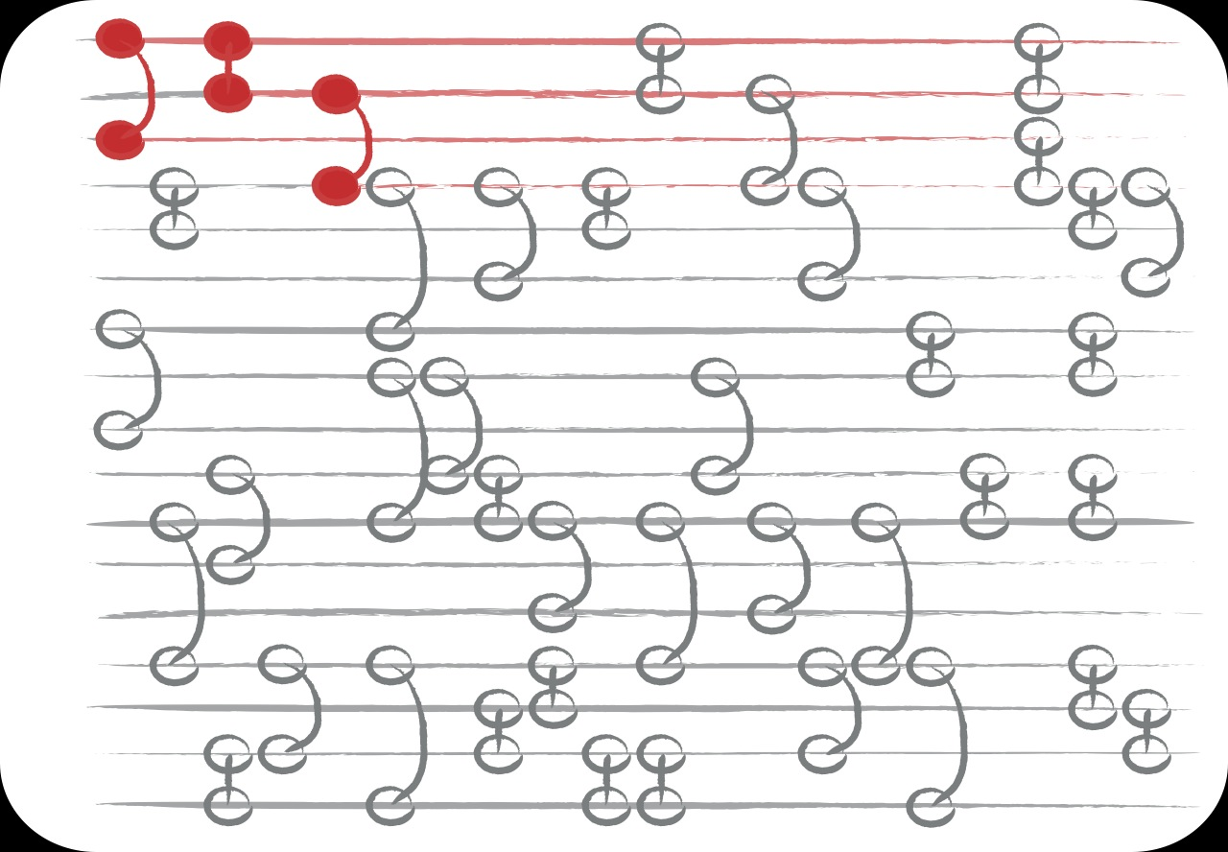
Disease spreading on temporal networks
time

Slide 57
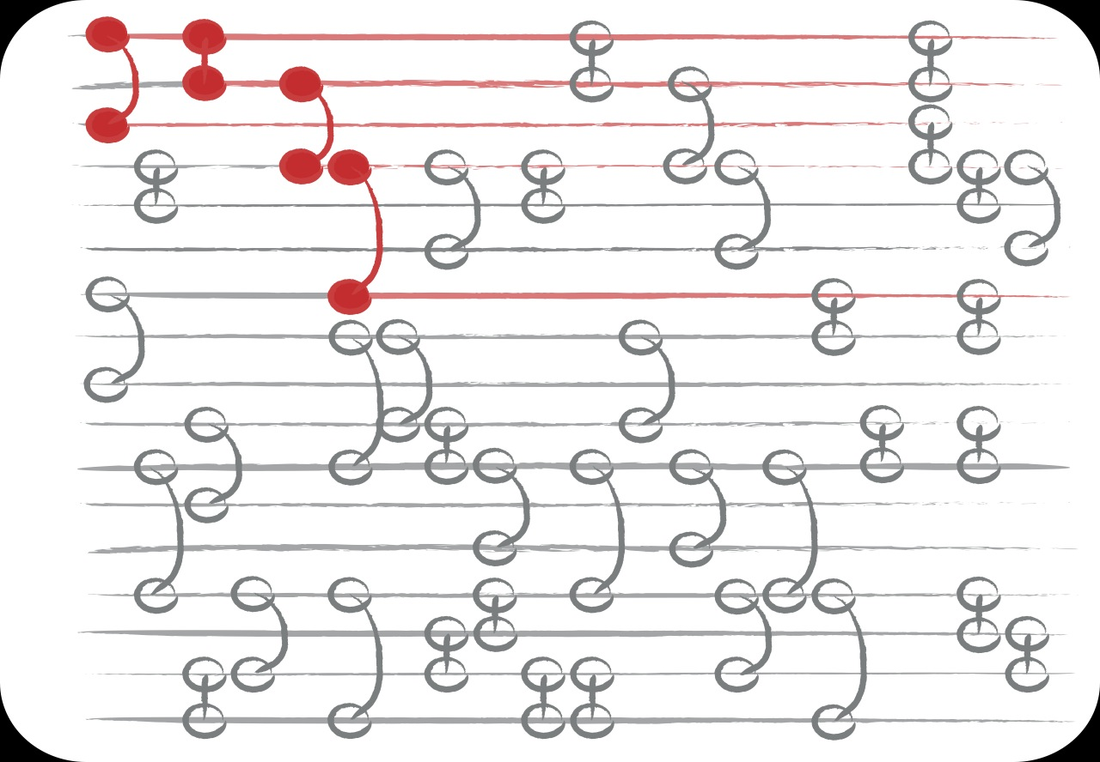
Disease spreading on temporal networks
time

Slide 58
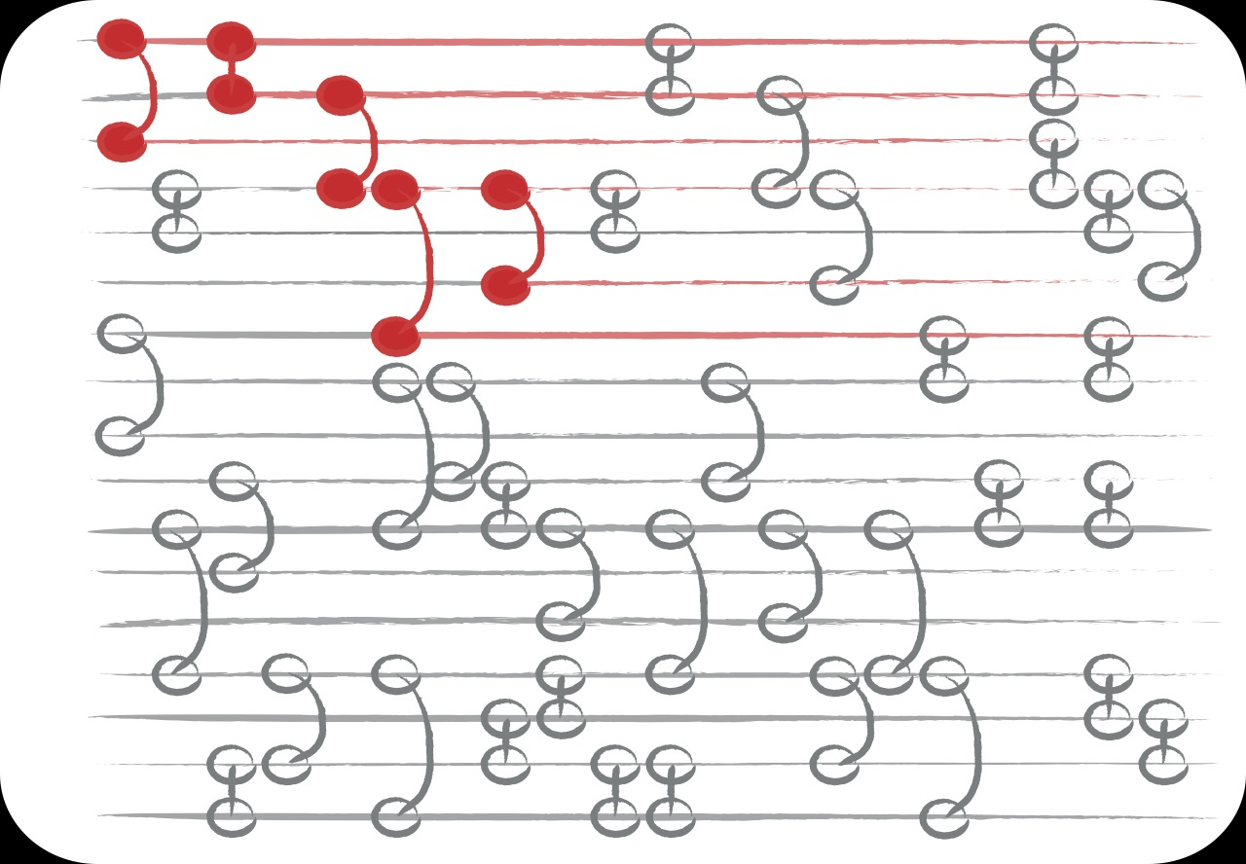
Disease spreading on temporal networks
time

Slide 59
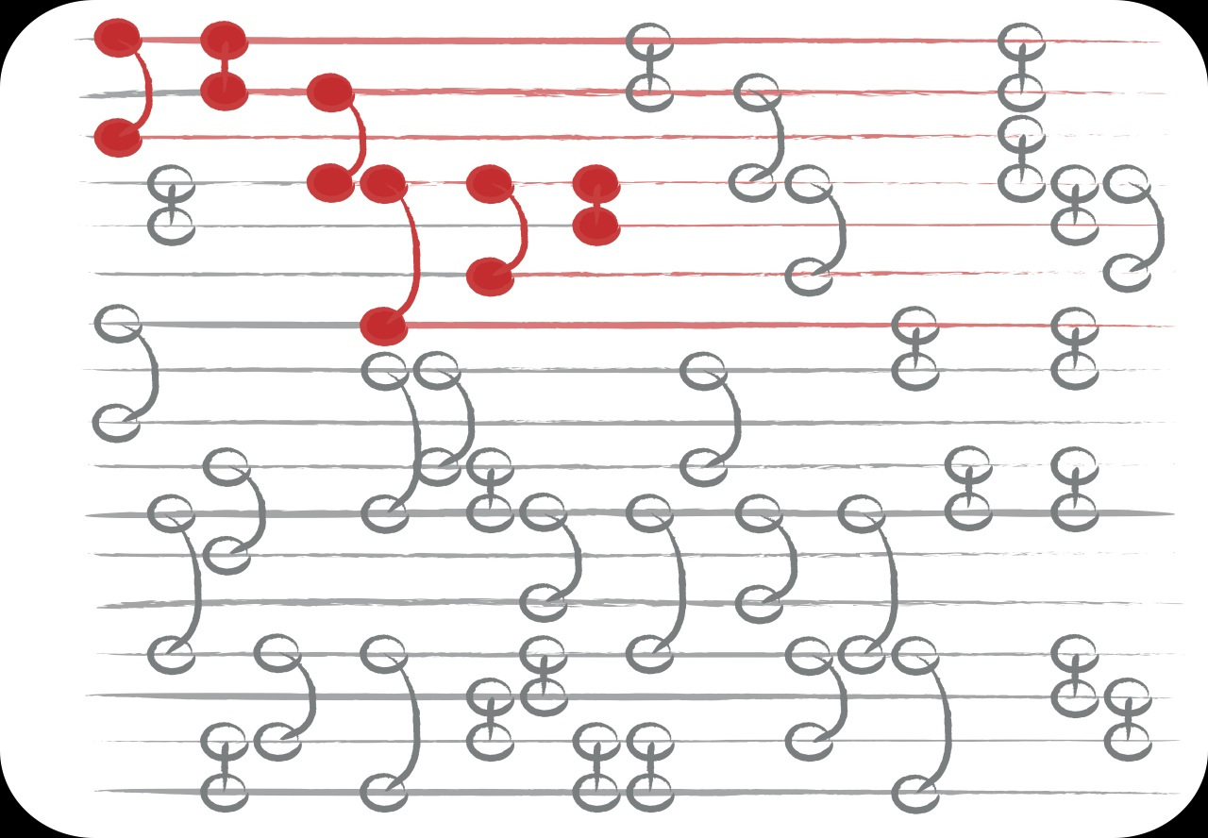
Disease spreading on temporal networks
time

Slide 60
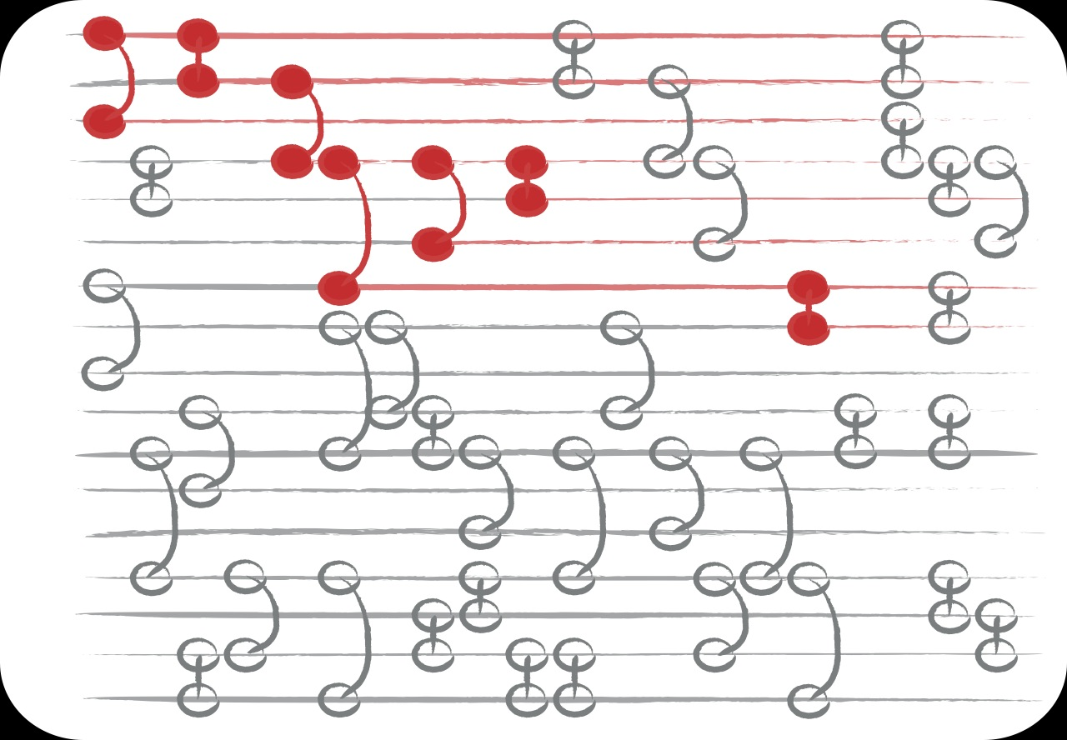
Disease spreading on temporal networks
time

Slide 61
Temporal networks
Riolo CS, Koopman JS, Chick SE, 2001. Methods and measures for the description of epidemiological contact networks. J Urban Health 78: 446-456.
Moody J, 2002. The importance of relationship timing for diffusion. Social Forces 81: 25-56.
Kempe D, Kleinberg J, Kumar A, 2002. Connectivity and inference problems for temporal networks. J Comput Syst Sci 64: 820-842.
Holme P, 2005. Network reachability of real world contact sequences. Phys Rev E 71: 046119.
Holme P, Saramäki J, 2011. Temporal Networks.

Slide 62
Temporal patterns of events matter

Slide 63
Temporal patterns of events matter
LEC Rocha, F Liljeros, P Holme, 2010. PNAS 107: 5706-5711.

Slide 64
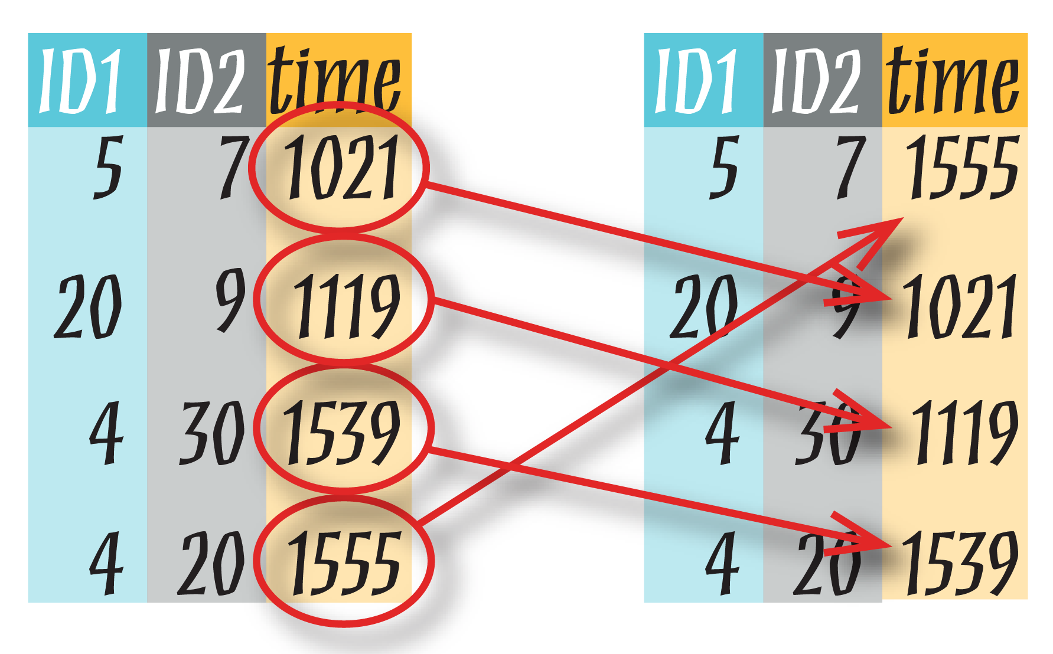
The order of events matter
LEC Rocha, F Liljeros, P Holme, 2010. PNAS 107: 5706-5711.
Escort/sex-buyer contacts: 16,730 nodes, 50,632 contacts over 2,232 d
LEC Rocha, F Liljeros, P Holme, 2011.
PLoS Comp Biol 7: e1001109.

Slide 65
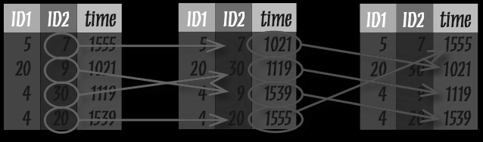
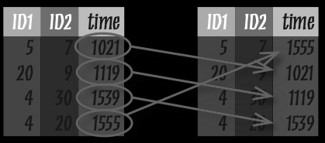
Other randomizations

Slide 66
Threshold in transmission probability

Slide 67
Lack of threshold in duration

Slide 68
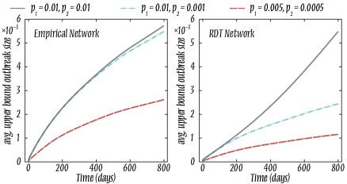
Two-stage HIV model

Slide 69
The vaccination problem

Slide 70
The vaccination problem
Imagine you can make a fraction f of a
population immune (or less contagious)
… then how can you find these people so the
vaccination is as effective as possible?

Slide 71
Neighborhood vaccination
Cohen, Havlin, Ben Avraham, 2003. Phys Rev Lett 91: 247901.

Slide 72
Neighborhood vaccination
Cohen, Havlin, Ben Avraham, 2003. Phys Rev Lett 91: 247901.
1. Pick a random person.

Slide 73
Neighborhood vaccination
Cohen, Havlin, Ben Avraham, 2003. Phys Rev Lett 91: 247901.
1. Pick a random person.
2. Ask for the name of a contact.

Slide 74
Neighborhood vaccination
Cohen, Havlin, Ben Avraham, 2003. Phys Rev Lett 91: 247901.
1. Pick a random person.
2. Ask for the name of a contact.
3. Vaccinate the contact & go to 1.
Notes:
Assumes the future contacts are known.

Slide 75
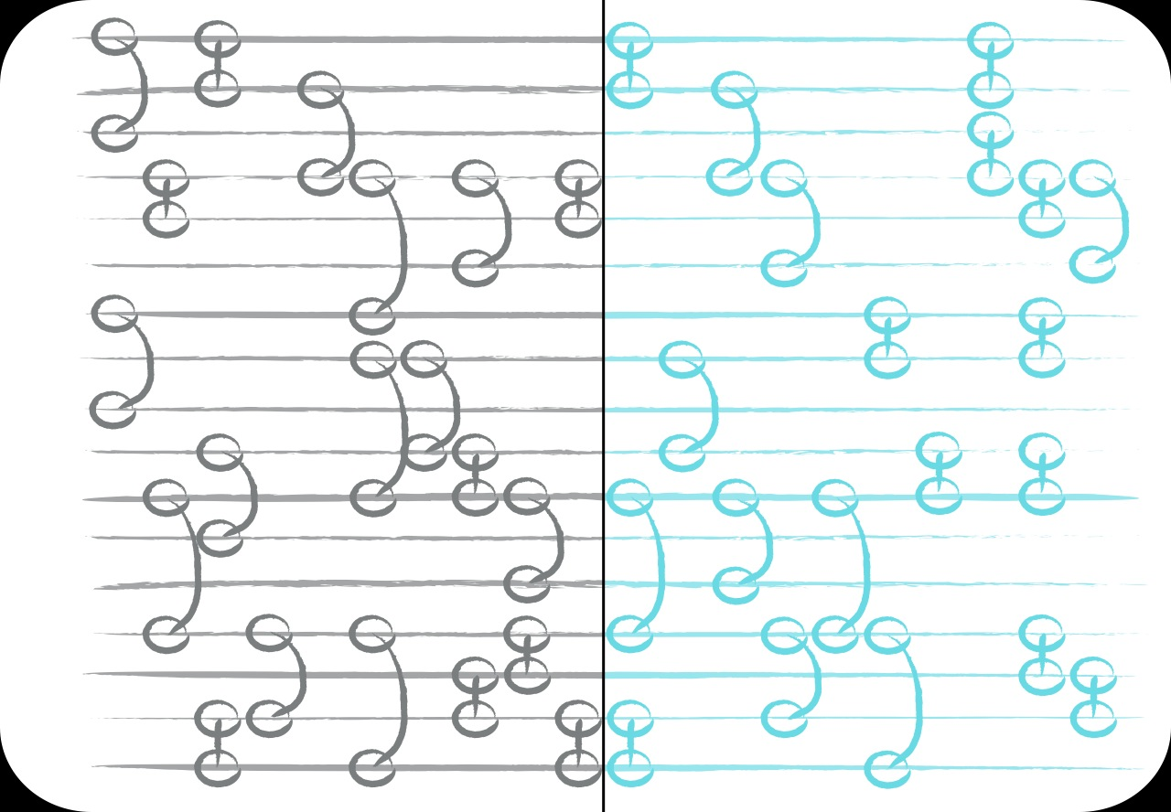
Neighborhood vaccination
time

Slide 76
Neighborhood vaccination
Experience—past
Epidemic reality—future

Slide 77
Can we make a protocol
like n.v. that exploits
temporal structure too?
S Lee, LEC Rocha, F Liljeros, P Holme. Exploiting temporal network structures of human interaction to effectively immunize populations. arXiv:1011.3928

Slide 78
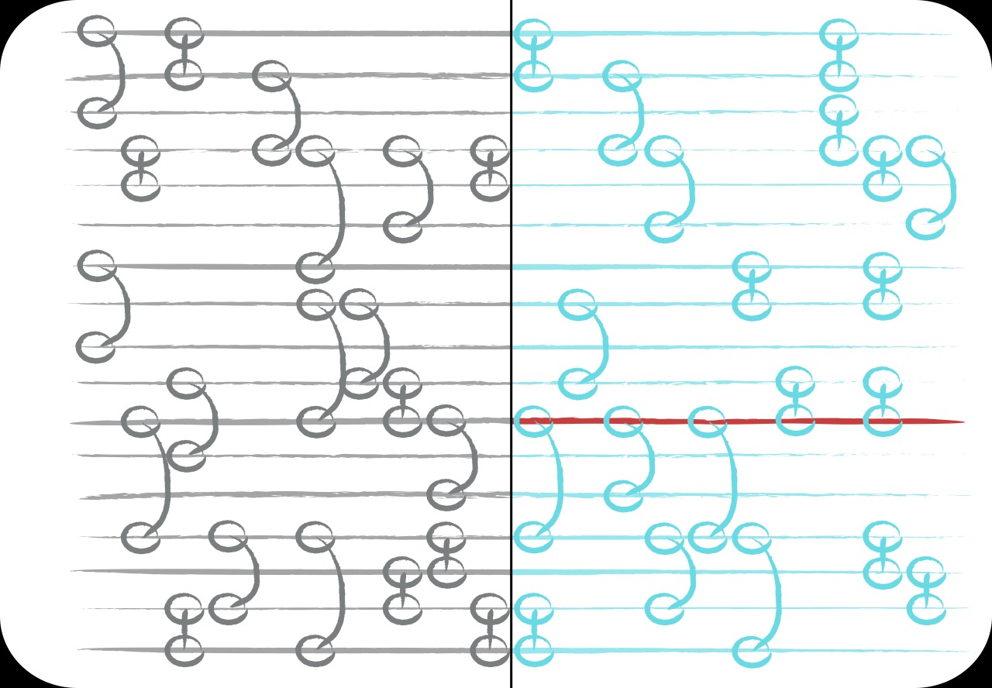
Simulation setup
time

Slide 79
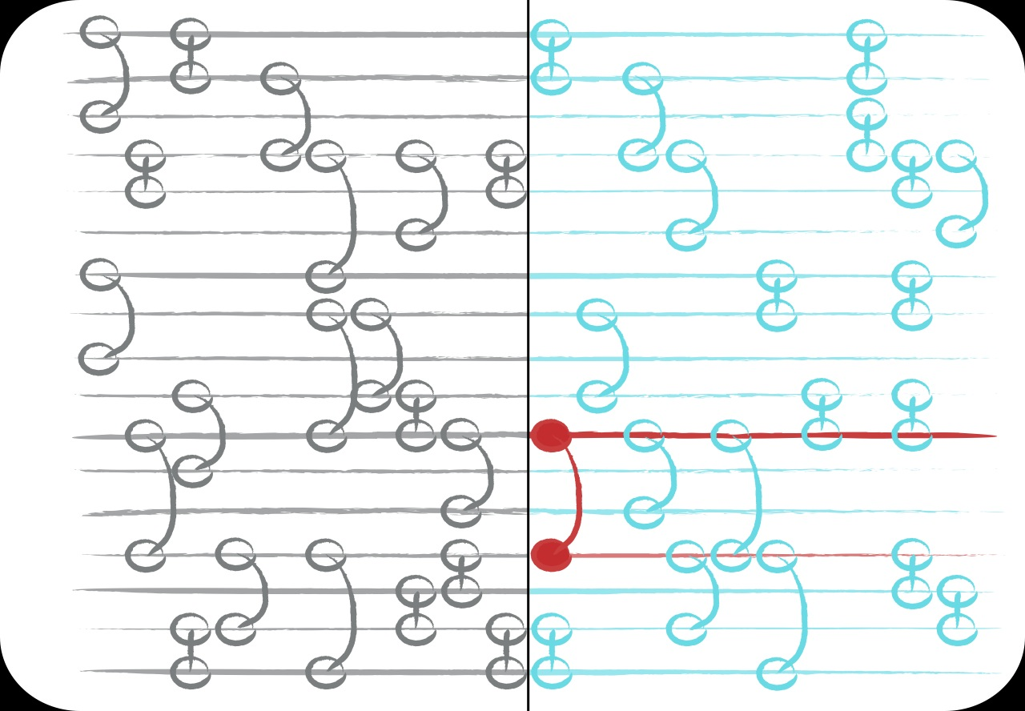
Simulation setup
time

Slide 80
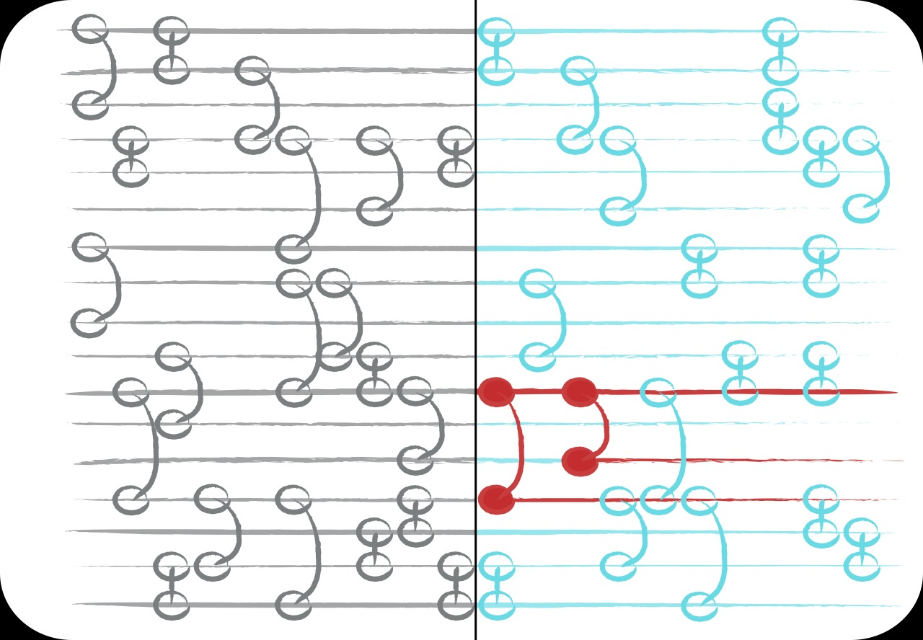
Simulation setup
time

Slide 81
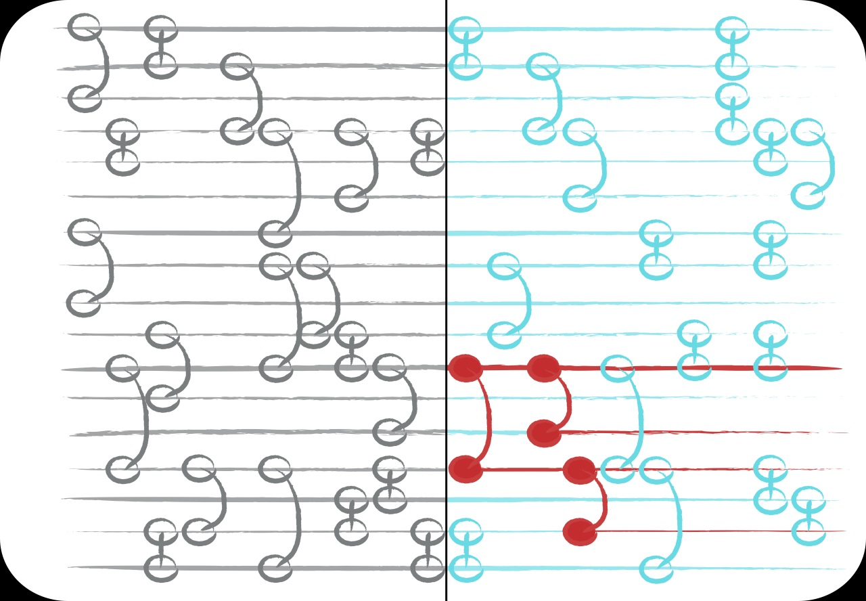
Simulation setup
time

Slide 82
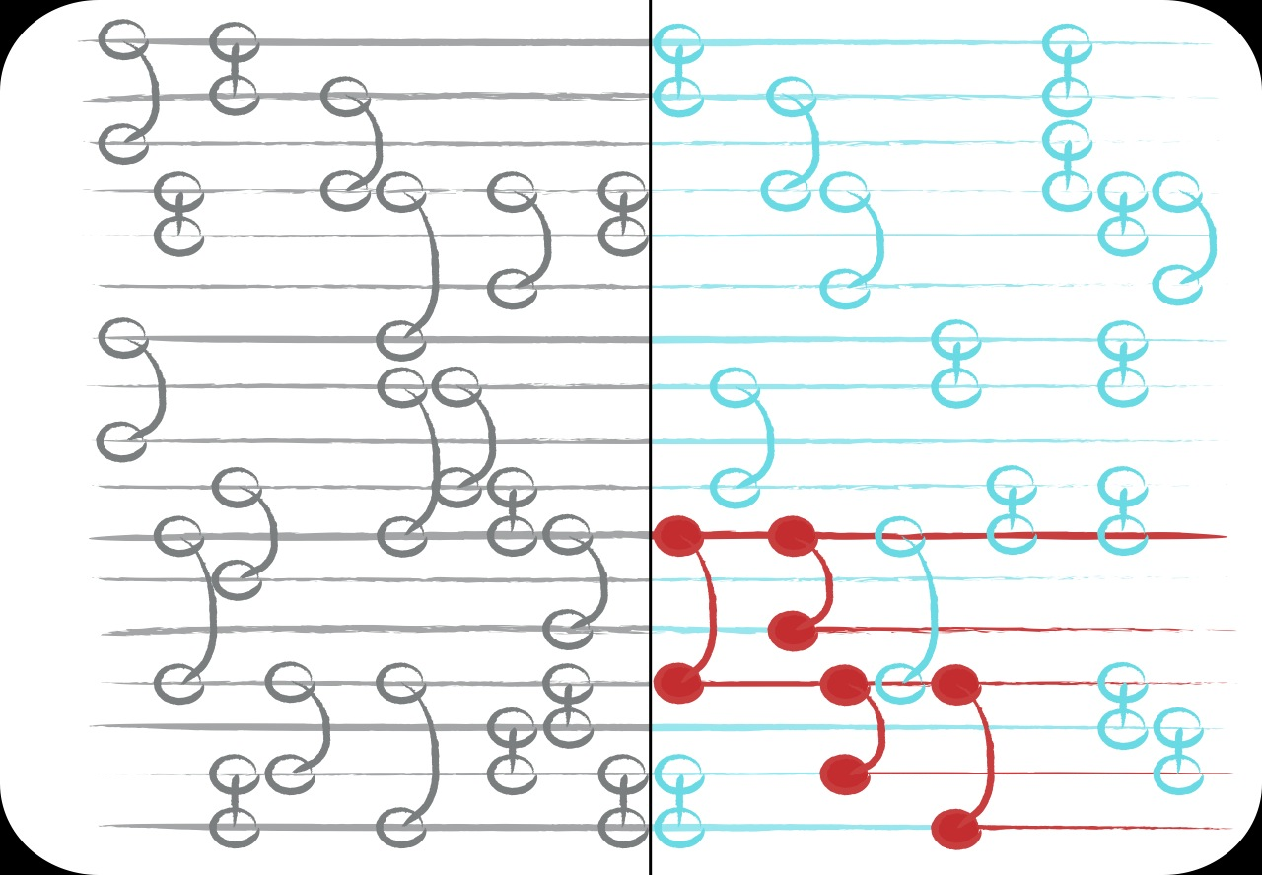
Simulation setup
time

Slide 83
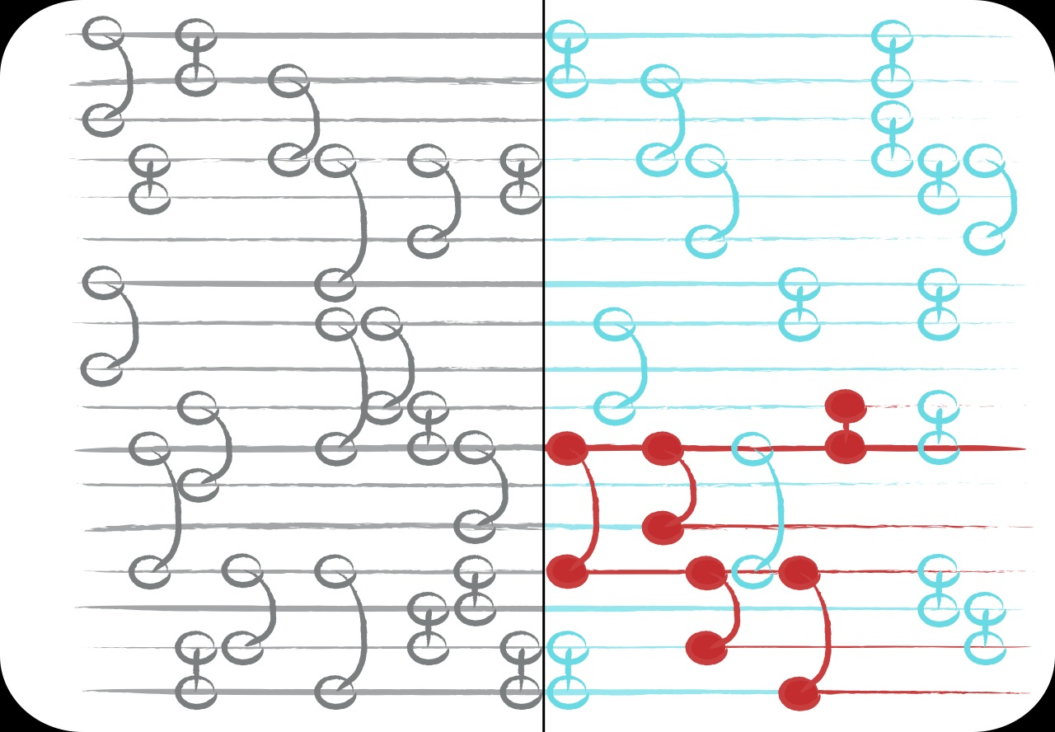
Simulation setup
time

Slide 84
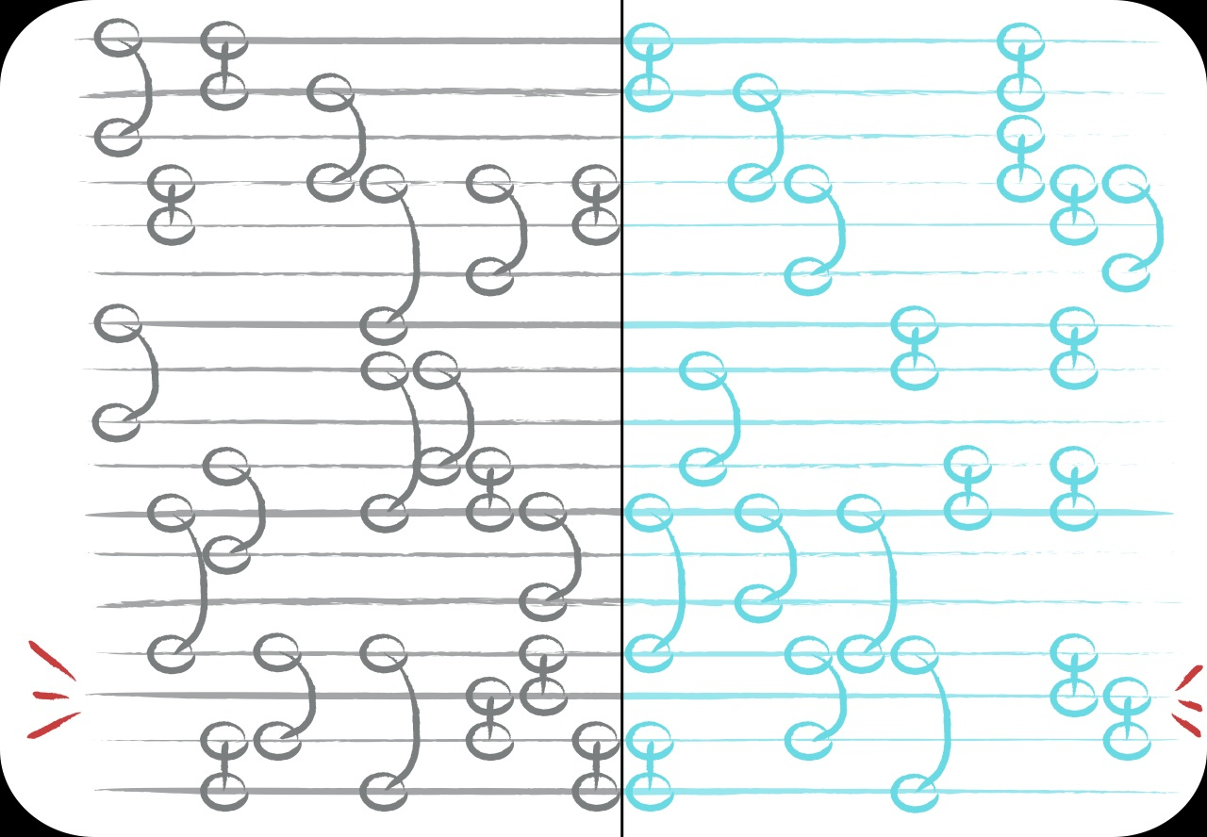
Recent
1. Pick a random person.
time

Slide 85
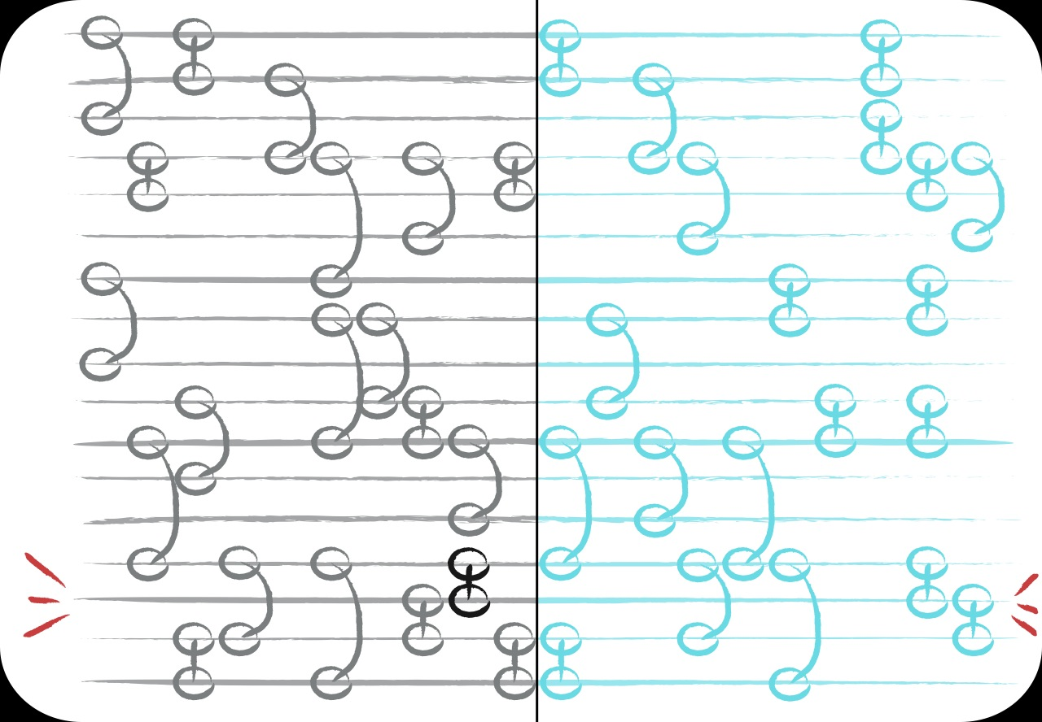
Recent
2. Ask for the name of the most recent contact.
time

Slide 86
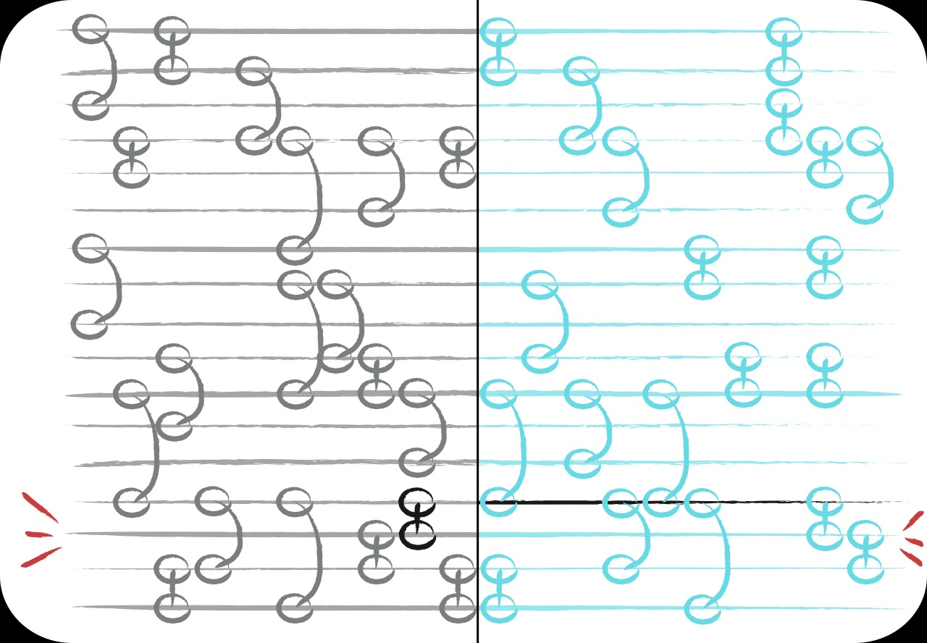
Recent
3. Vaccinate that contact & go to 1.
time

Slide 87
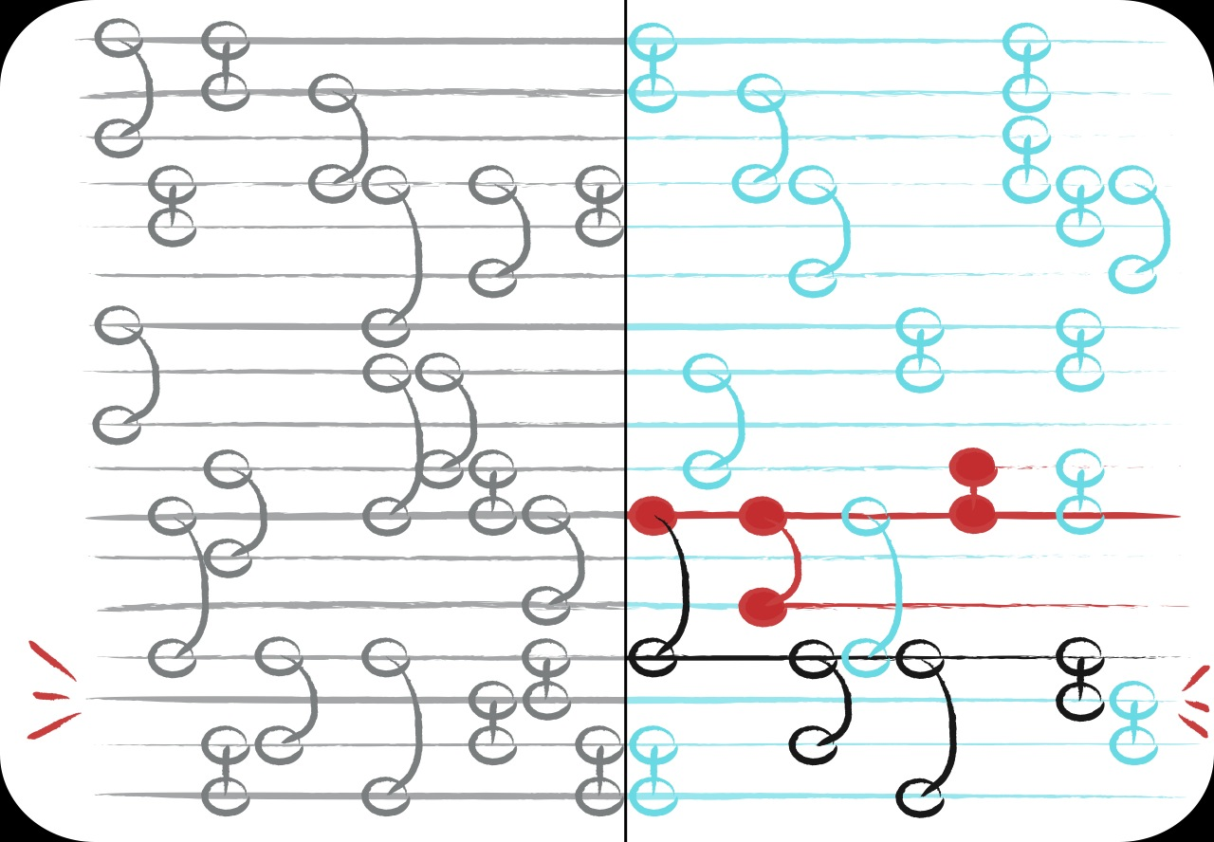
Recent
time

Slide 88

Weight
1. Pick a random person.
time

Slide 89
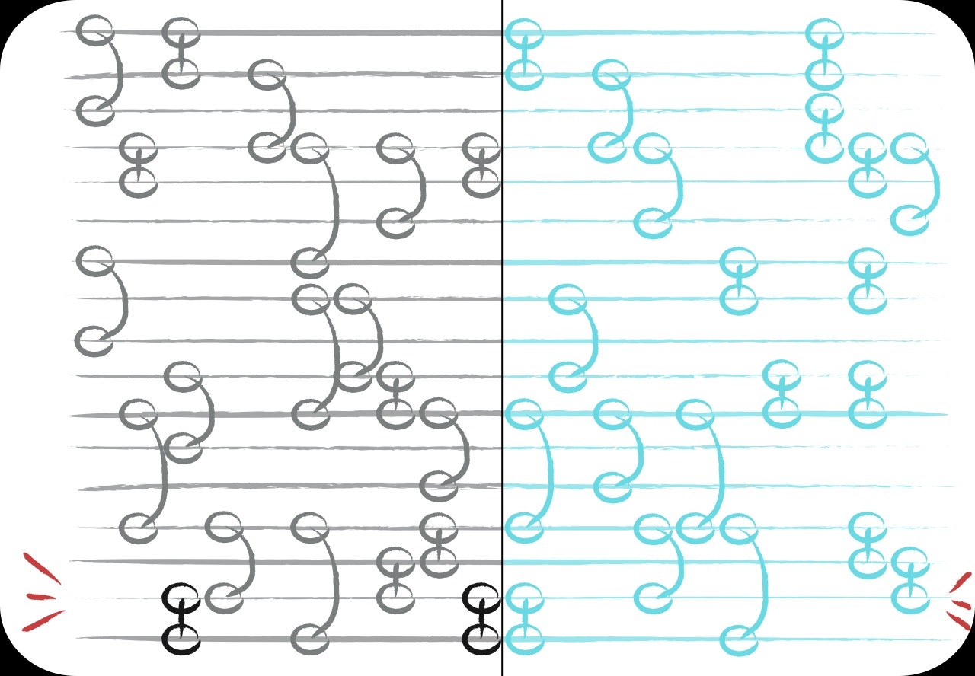
Weight
2. Ask for the name of the most frequent contact.
time

Slide 90
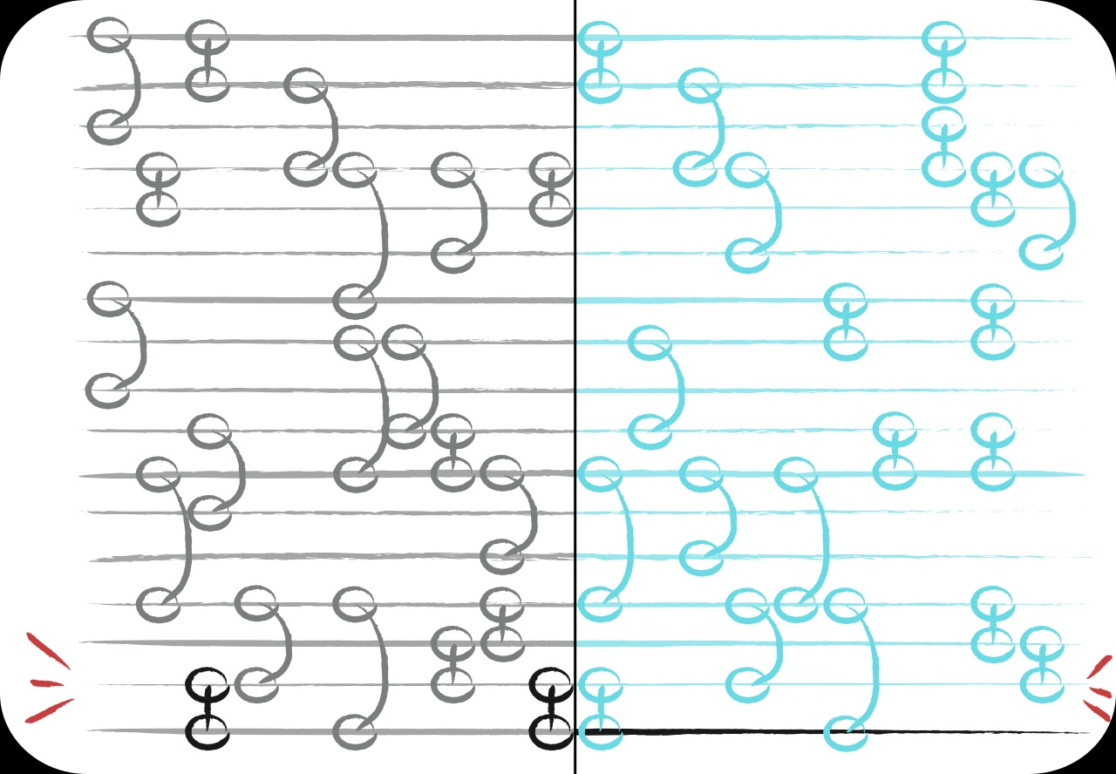
Weight
3. Vaccinate that contact & go to 1.
time

Slide 91
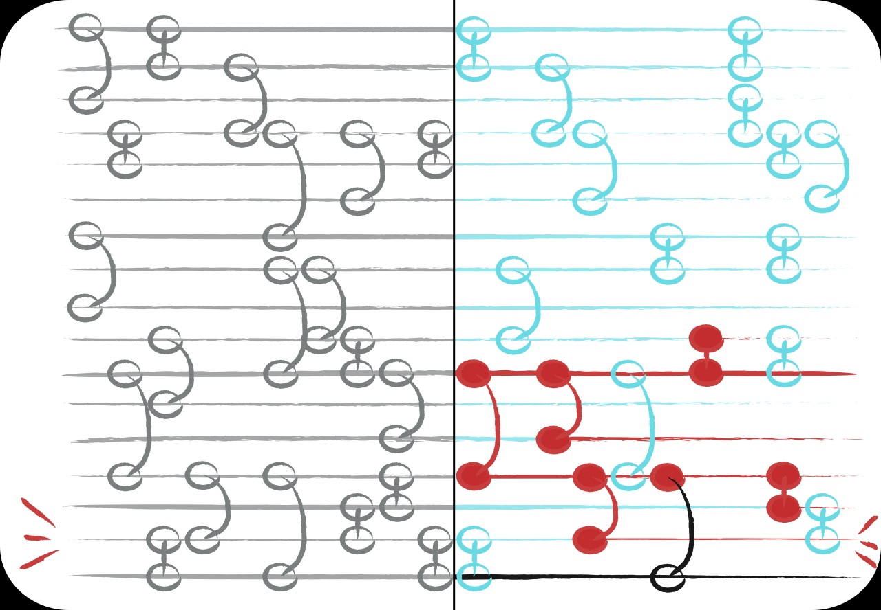
Weight
time

Slide 92
Numerical results

Slide 93
Datasets
 | # vertices | # edges | duration (days)
E-mail | 3,188 | 309,125 | 83
Internet dating | 29,341 | 536,276 | 512
Hospital | 295,107 | 64,625,283 | 8,521
Prostitution | 16,730 | 50,632 | 2,232

Slide 94
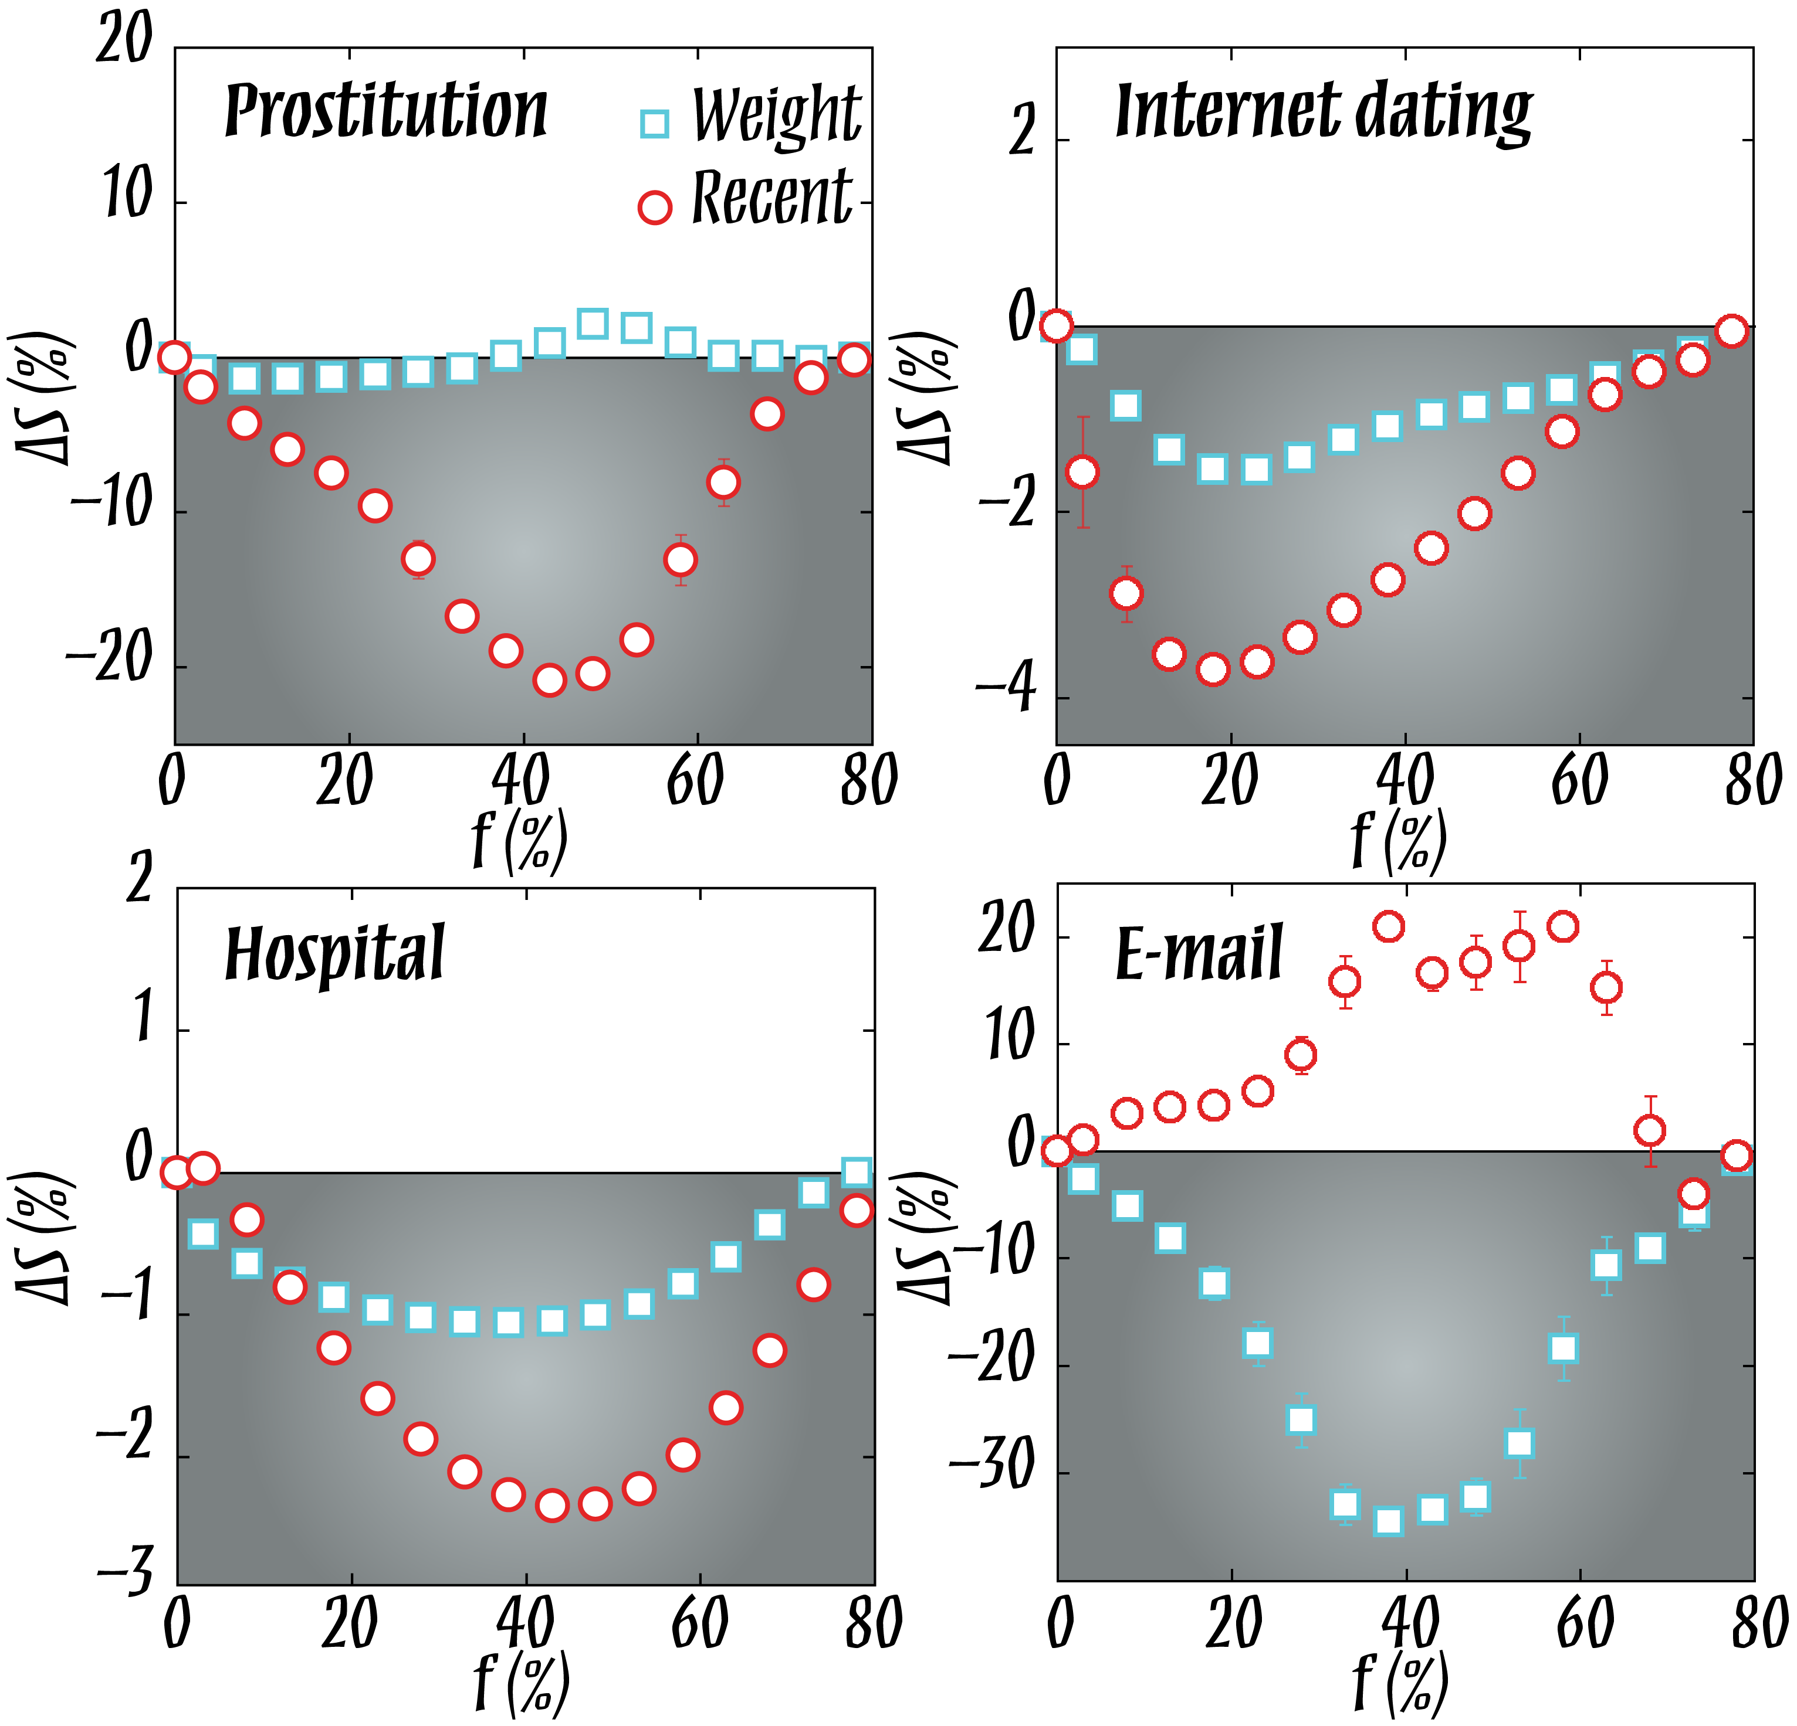
Upper bound on outbreak size

Slide 95
Susceptible–Infected–Susceptible

Slide 96
Susceptible–Infected–Susceptible

Slide 97
Degree distributions

Slide 98
Models of edge-dynamics

Slide 99
Models of edge-dynamics

Slide 100
Medical
Applications?
Hepatitis B
HIV PrEP & counseling
Partner treatment
Contact tracing

Slide 101
A little summary
The temporal-network approach:
Moving when contacts happen from the disease spreading model to the contact network
+
If there is structure in the temporal aspects of contacts, we can better understand, predict and control spreading phenomena.
Fits the data format from many sources.
Many open questions.
–
Harder to get rigorous results.
Harder to conceptualize.

